Slide 1

Week #6
AI Academy®
1
Day 1, 2, 3:
PHP Functions
Why we use?
PHP Arrays
Array Sorting with Functions
PHP Forms & DB Connectivity
Reviews & Feedbacks

Slide 2
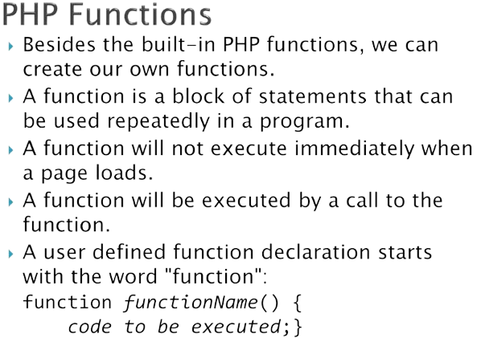
Week #6
AI Academy®
1

Slide 3
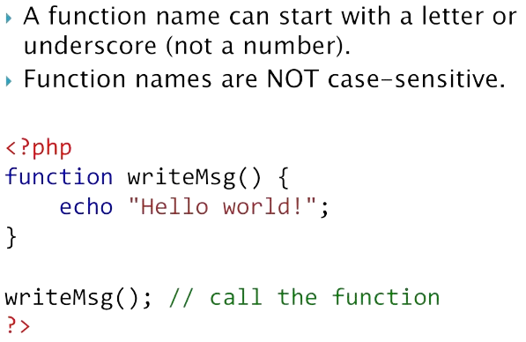
Week #6
AI Academy®
1

Slide 4
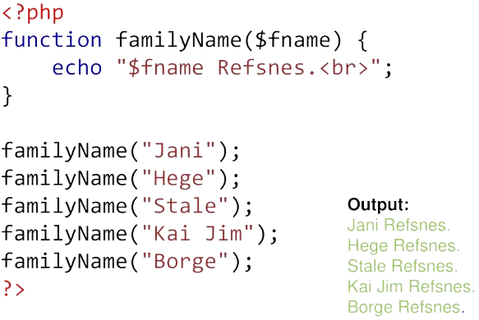
Week #6
AI Academy®
1

Slide 5
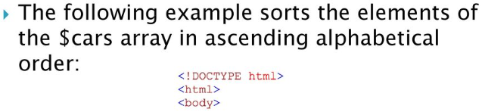
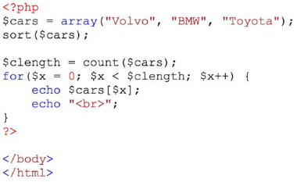
Week #6
AI Academy®
1

Slide 6
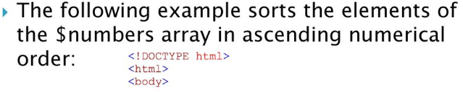
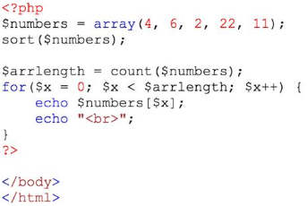
Week #6
AI Academy®
1

Slide 7
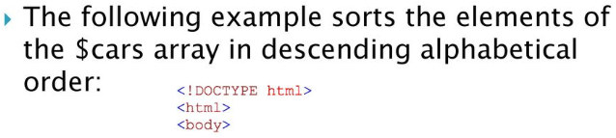
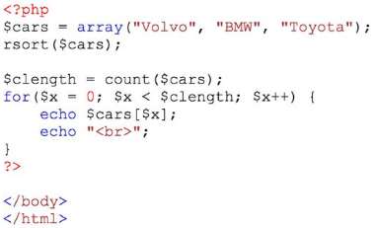
Week #6
AI Academy®
1

Slide 8
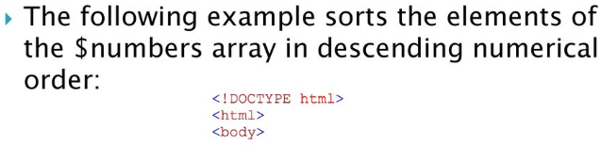
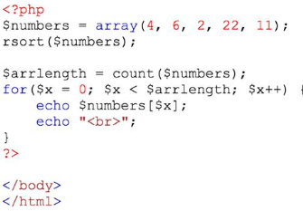
Week #6
AI Academy®
1

Slide 9

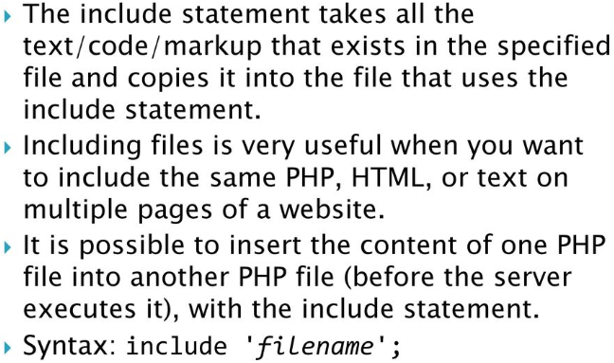
Week #6
AI Academy®
1

Slide 10
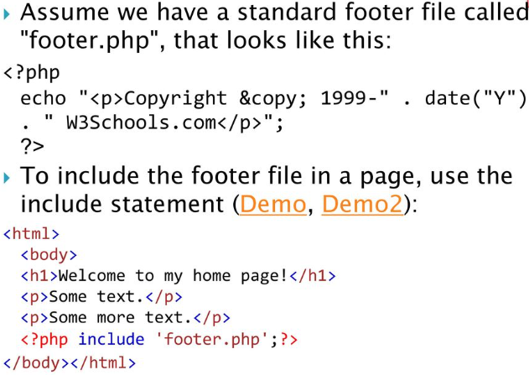
Week #6
AI Academy®
1

Slide 11
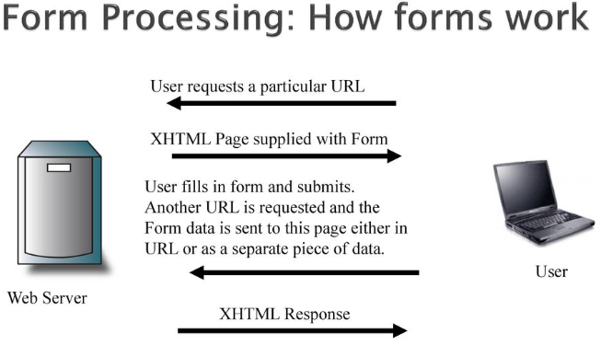
Week #6
AI Academy®
1

Slide 12

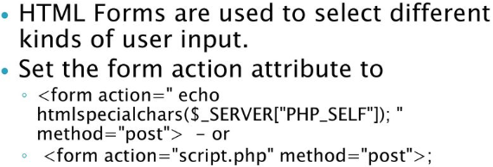
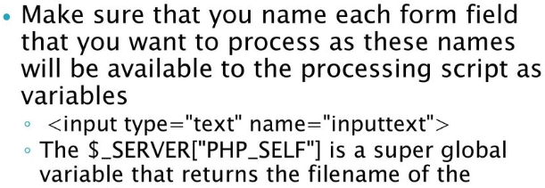
Week #6
AI Academy®
1

Slide 13

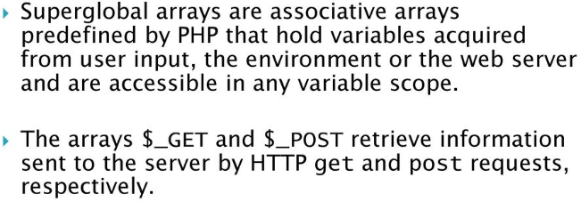
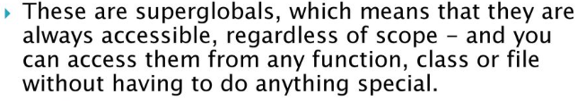
Week #6
AI Academy®
1

Slide 14
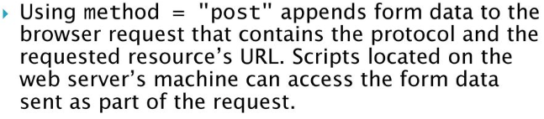
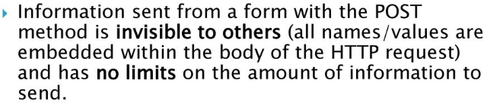
Week #6
AI Academy®
1
Form Coding Updated on Github!

Slide 15
Week #6
AI Academy®
7
Day 4, 5:
Mid Term Assessment
Project Presentation
Reviews & Feedbacks

